Slide 1
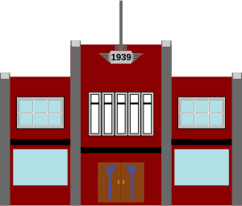
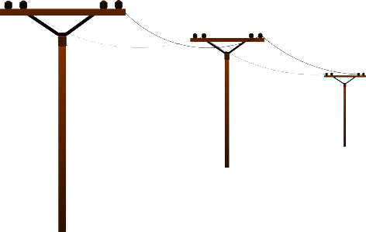
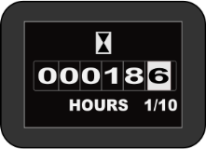
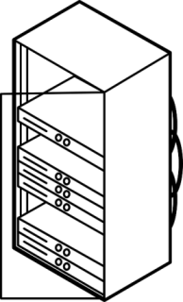
a
METER
b
Every 30 min
a
b
Bristol City Council
DATA SERVER

Slide 2
How you get your data
Electricity usage is measured by your meter
Every 30 minutes the kWh used gets sent using the GPRS network (like SMS) to a central Data Server
The Data Server stores the data and makes it available to the council and to our servers.
The Council provides your school business manager with a report on electricity consumption and monitors usage in over 1,000 properties across Bristol. We use the data to work out an average consumption for schools in the project.
Your school business manager plans budgets. You plan lessons and use the data from our server in the classroom.

